Slide 1
IBM University Engagement Project Submission
“Exploring the Power of Agentic AI with IBM Granite and LangFlow”

Slide 2

Project Tile – EduSimplify AI – Personalized Course Content Simplification Agent
Domain of Project – Education
Student Name | Recent Passport Photo | Email ID | Mobile number [WhatsApp]
Pavithra R |  | 1606pavi@gmail.com | 9901541939
Recommended font style and size:
Font Style: Arial
Font Size (Heading): 28
Font Size (Content): 20

Slide 3
Problem Statement -
Problem Statement : Course Content Simplification Agent
The Challenge
Academic materials can be difficult and technical, especially for students with different levels of prior knowledge. Complex terminology, lengthy explanations, and unfamiliar concepts can make learning challenging. The same explanation may not work equally well for beginners, intermediate, and advanced learners.
The Objective
Develop an AI-powered Course Content Simplification Agent that converts academic content into level-appropriate explanations, making learning more personalized and inclusive.
The System Should
Adapt content for Beginner, Intermediate, and Advanced learners.
Analyze textbooks, notes, and PDFs to identify key concepts and terminology.

Slide 4
Key Capabilities
To address these challenges, the system should provide the following capabilities:
Level-Based Learning – Present concepts with the right amount of detail and technical depth for each learner.
Multilingual Support – Make the same content available in multiple languages while retaining essential technical terms.
Better Concept Understanding – Support difficult topics using analogies, practical examples, key ideas, and important terms.
Exam Support – Convert the material into exam-focused points, revision notes, and MCQ quizzes.
Interactive Input – Allow students to paste text or upload PDFs and generate learning content based on their preferences.
Save & Revise – Let students download the generated notes for later revision.

Slide 5
Proposed Solution -
Proposed Solution: EduSimplify AI – Course Content Simplification Agent
EduSimplify AI is an AI-based learning assistant that transforms complex academic material into clear and personalized study content.
The system considers the learner’s proficiency level, language preference, and explanation needs while generating the content.
Students can provide text or PDF-based course material. The system identifies important concepts, terminology, examples, and learning points, then restructures the content for the selected level: Beginner, Intermediate, or Advanced.
Core Modules
Content Analysis Module – Identifies key concepts, terminology, and essential information from the provided material.
Personalization Module – Adjusts the complexity and depth of explanations according to the selected learner level.

Slide 6
Multilingual Learning Module – Provides explanations in English, Kannada, Hindi, Tamil, and Telugu while preserving important technical terms.
Learning Assistance Module – Supports understanding through analogies, practical examples, key concepts, terminology, and simplified explanations.
Exam Preparation Module – Generates exam points, quick revision notes, and 5 MCQs with answers from the given content.
Streamlit Interface – Allows students to enter text or upload PDFs, select preferences, and generate personalized learning material.
AI Generation Component – Combines the source material with learner requirements to produce explanations, analogies, examples, exam points, revision notes, quizzes, and a one-line summary.
Overall, EduSimplify AI functions as an end-to-end personalized learning assistant that helps students understand, learn, and revise academic content according to their proficiency level.

Slide 7
Technology Used
LangFlow – Used to visually create and manage AI workflows and agent processes.
IBM Granite Model – Handles language understanding, simplification, reasoning, summarization, and content personalization.
IBM Cloud – Provides a secure and scalable environment for developing and deploying the system.
RAG (Retrieval-Augmented Generation) – Retrieves relevant information from trusted academic sources to improve the accuracy of generated content.
IBM watsonx.ai – Supports foundation models, embeddings, AI development, and governance.
Vector Database (FAISS/Chroma) – Stores content embeddings and enables efficient retrieval for the RAG pipeline.
Streamlit – Provides the interactive interface for uploading PDFs, entering text, choosing preferences, and viewing results.
Python – Used for PDF processing, AI integration, prompt handling, and application logic.

Slide 8
Langflow component Used -
1) Chat Input – Students enter course content, questions, learning level, preferred language, and explanation preferences.
2) IBM watsonx.ai Agent – Uses IBM Granite models to process the input and adapt the content to the selected proficiency level.
3) IBM Granite Model – Granite-4.0-8B-Instruct – Performs language understanding, reasoning, summarization, and personalized content generation.
4) Chat Output – Presents simplified explanations, analogies, key concepts, examples, exam points, revision notes, and MCQ quizzes.
5) File Component – Enables students to upload academic PDFs, which are passed to the AI workflow for analysis and simplification.
6) Prompt Template – Organizes the student’s content and preferences into structured instructions for generating personalized learning material.

Slide 9
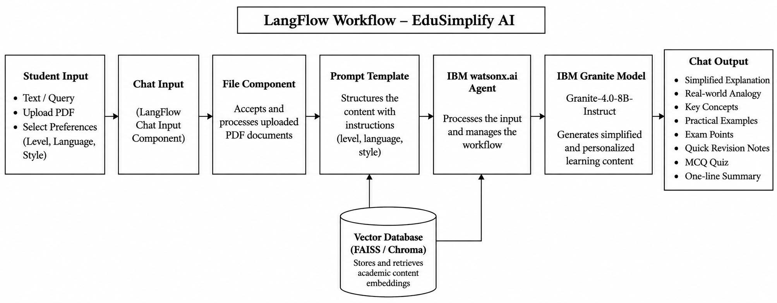
Langflow workflow -

Slide 10

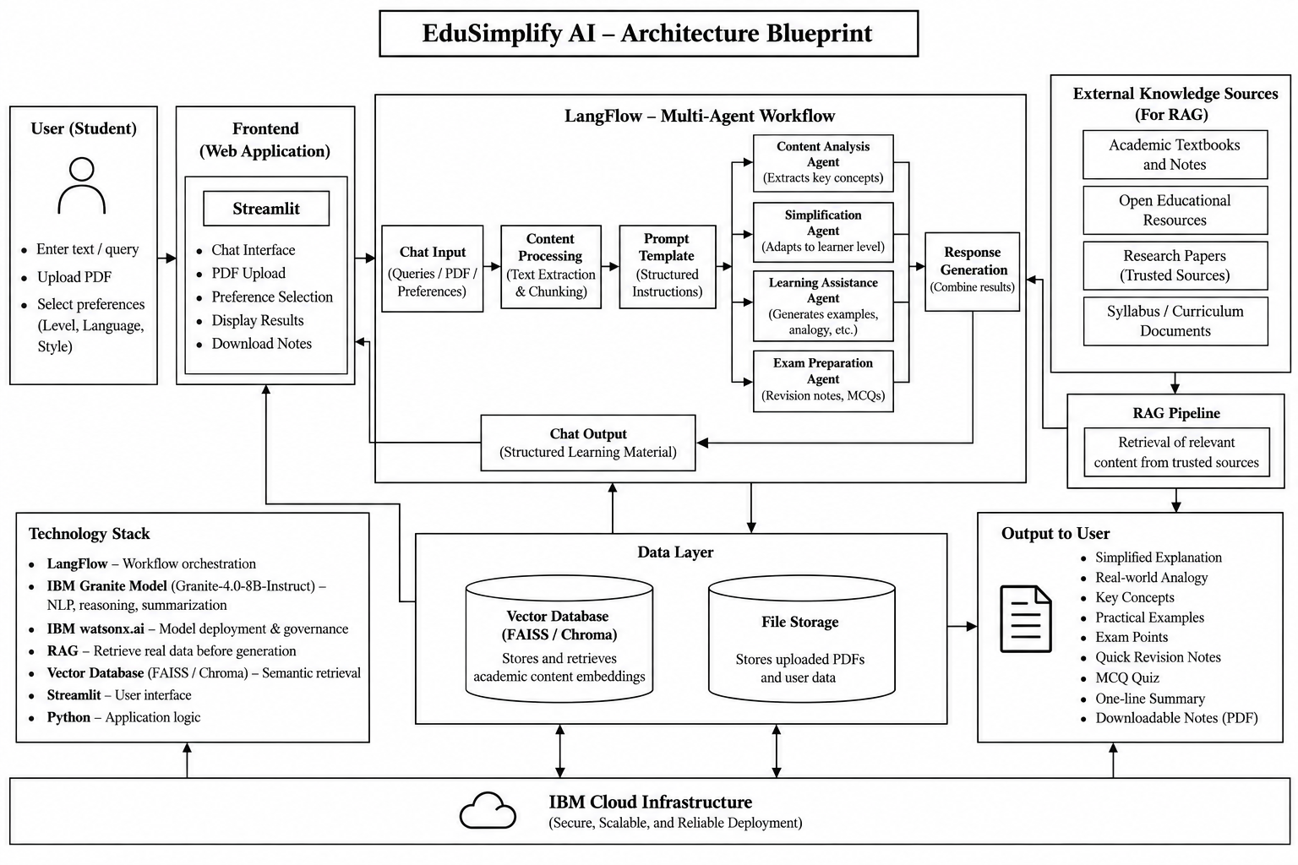

Slide 11

Role of Agentic AI in the solution
Agentic AI allows EduSimplify AI to go beyond basic question answering by understanding the course material and learner needs, then creating suitable learning content.
• Content Understanding – Examines text/PDFs to extract key concepts and terminology.
• Learner Adaptation – Adjusts explanation complexity for Beginner, Intermediate, or Advanced learners.
• Personalized Content – Creates explanations, analogies, examples, revision notes, and quizzes based on learner preferences.
• Multilingual Support – Generates content in the chosen language while keeping essential technical terms.
• Context Awareness – Combines the provided material with relevant retrieved information to maintain context and improve responses.
• Task Coordination – Handles multiple stages, including analysis, simplification, learning support, and exam preparation, as one workflow.
• Interactive Learning – Dynamically responds to student inputs and changing preferences.

Slide 12
Novelty and Uniqueness
EduSimplify AI brings Agentic AI, adaptive learning, personalization, multilingual support, and content simplification together in one educational platform.
• Adaptive Learning – Changes the complexity and detail of explanations based on the learner’s Beginner, Intermediate, or Advanced level.
• Personalized Explanations – Adjusts content according to the student’s level, language, and preferred explanation style.
• Multilingual Access – Supports English, Kannada, Hindi, Tamil, and Telugu, improving access to technical academic content.
• Smart Content Simplification – Transforms complex material into easy explanations, analogies, practical examples, and key concepts.
• Exam Preparation – Creates exam-focused points, revision notes, and MCQ quizzes directly from the learning content.
• PDF-to-Learning Conversion – Converts lengthy academic PDFs into structured and easier-to-understand study material.
• Integrated Agent Workflow – Combines content analysis, simplification, learning support, and exam preparation into one coordinated process.
• Inclusive Learning – Enables students with different knowledge levels to learn the same topic at a suitable level of complexity.

Slide 13
Git Hub Link
Github URL – https://github.com/pavi-thra-r/Edusimplify-AI.git
·
·
·

Slide 14
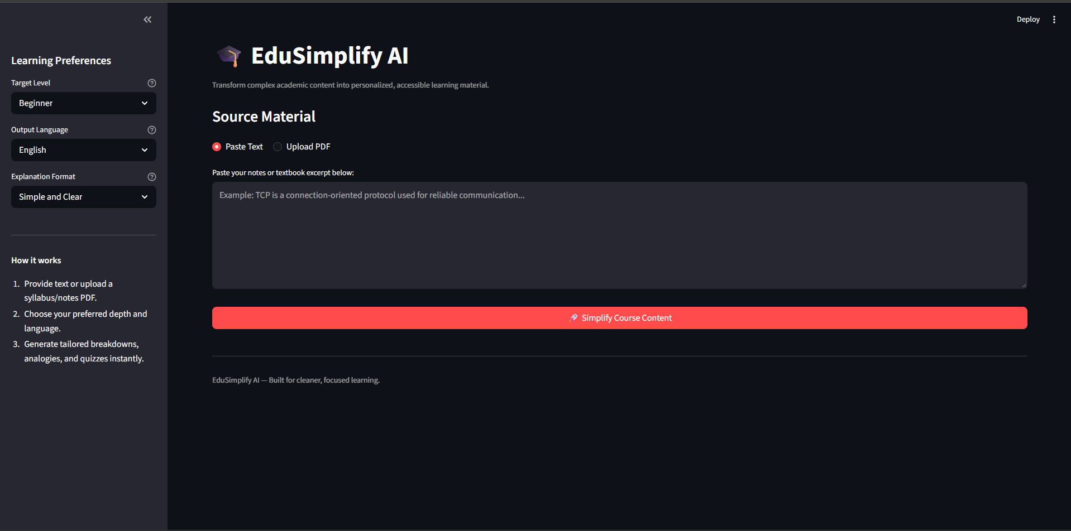
Project Screenshots
Home / Input Screen

Slide 15
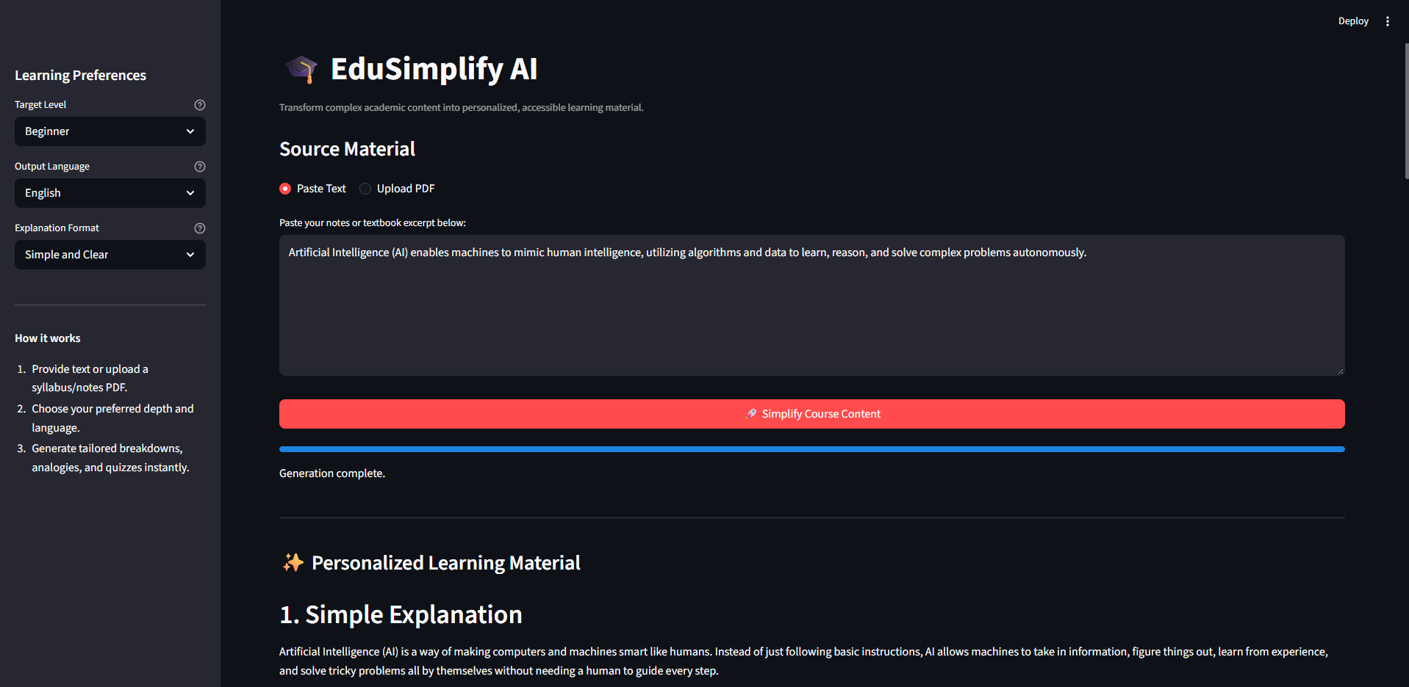
Personalized Learning Output

Slide 16
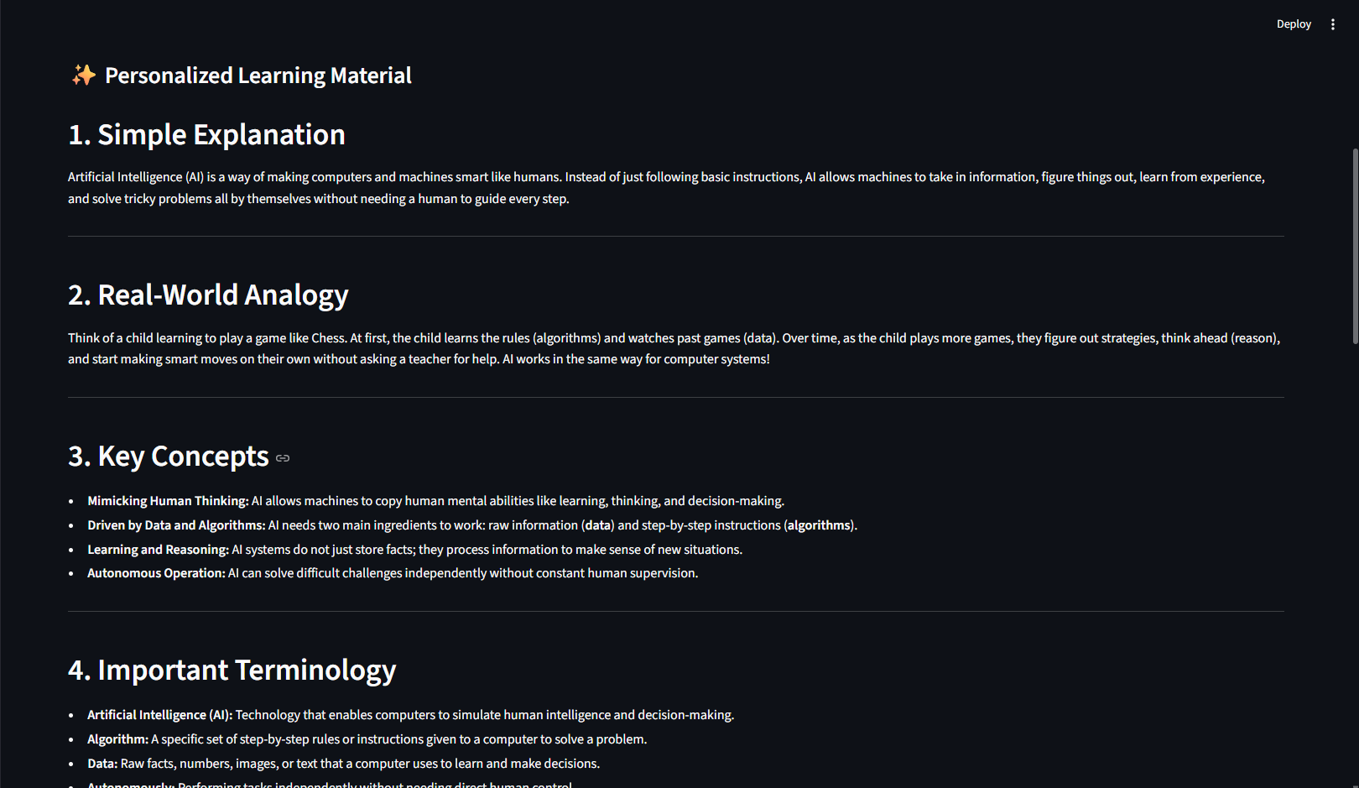
Personalized Learning Output

Slide 17
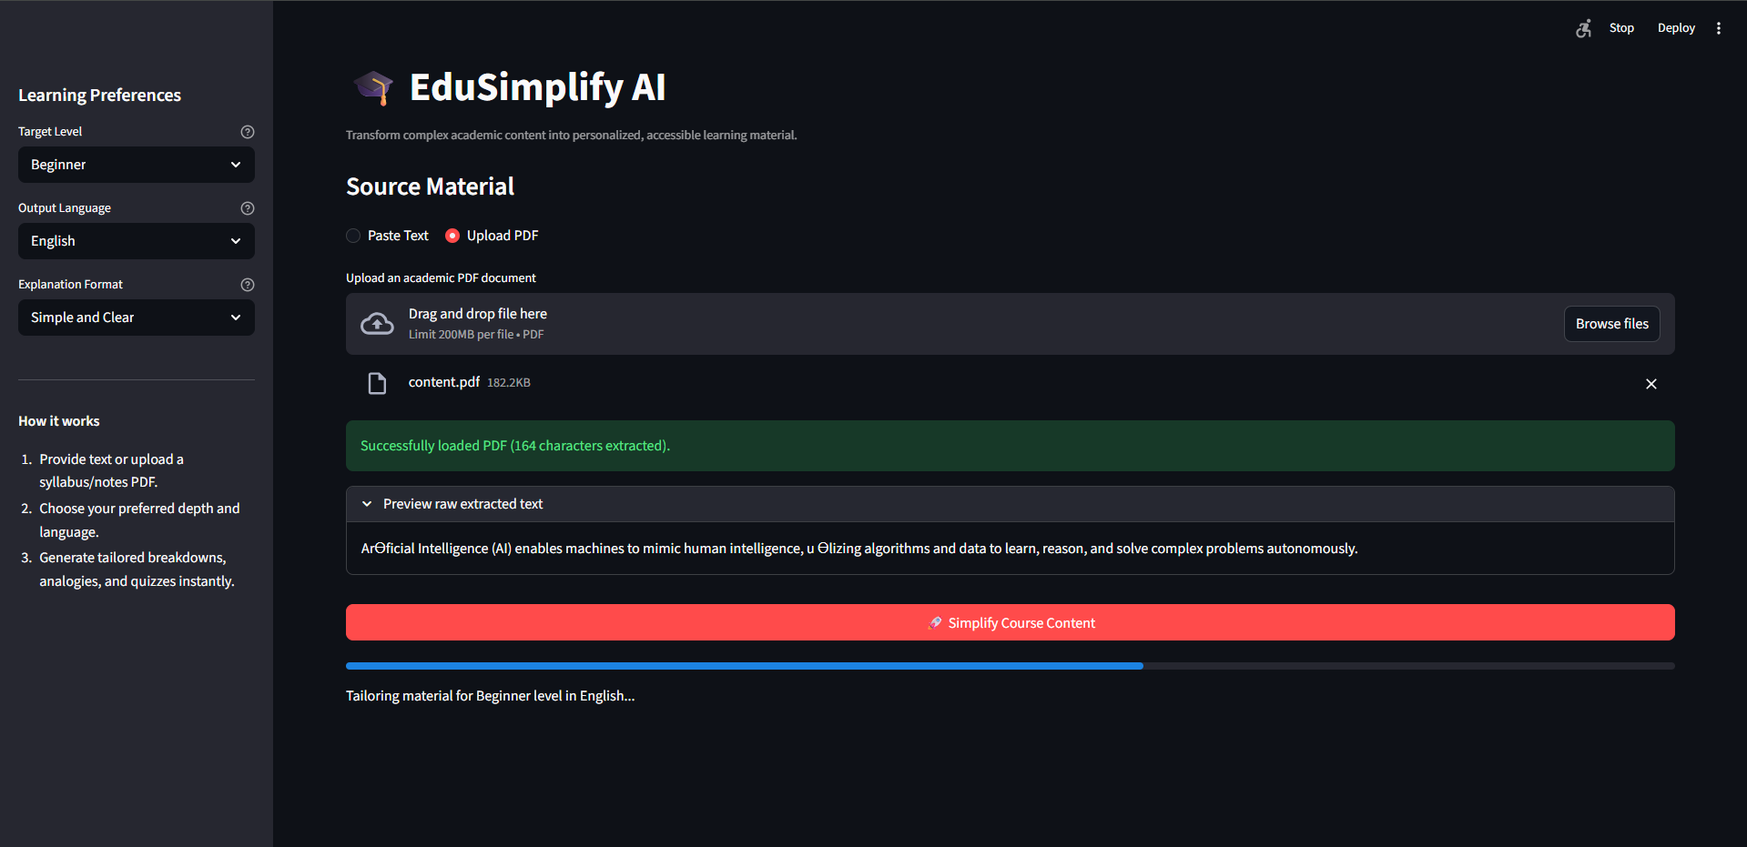
PDF Upload Screen

Slide 18
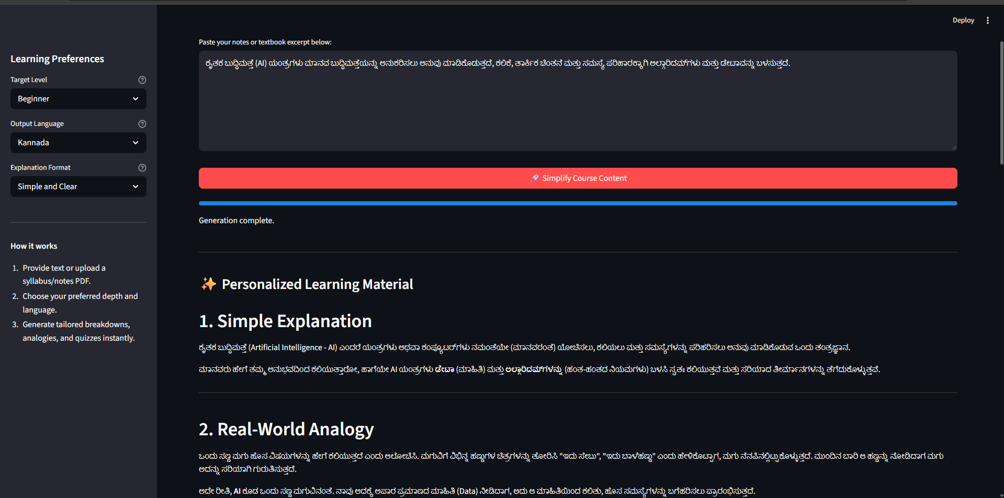
Multilingual Learning Option

Slide 19
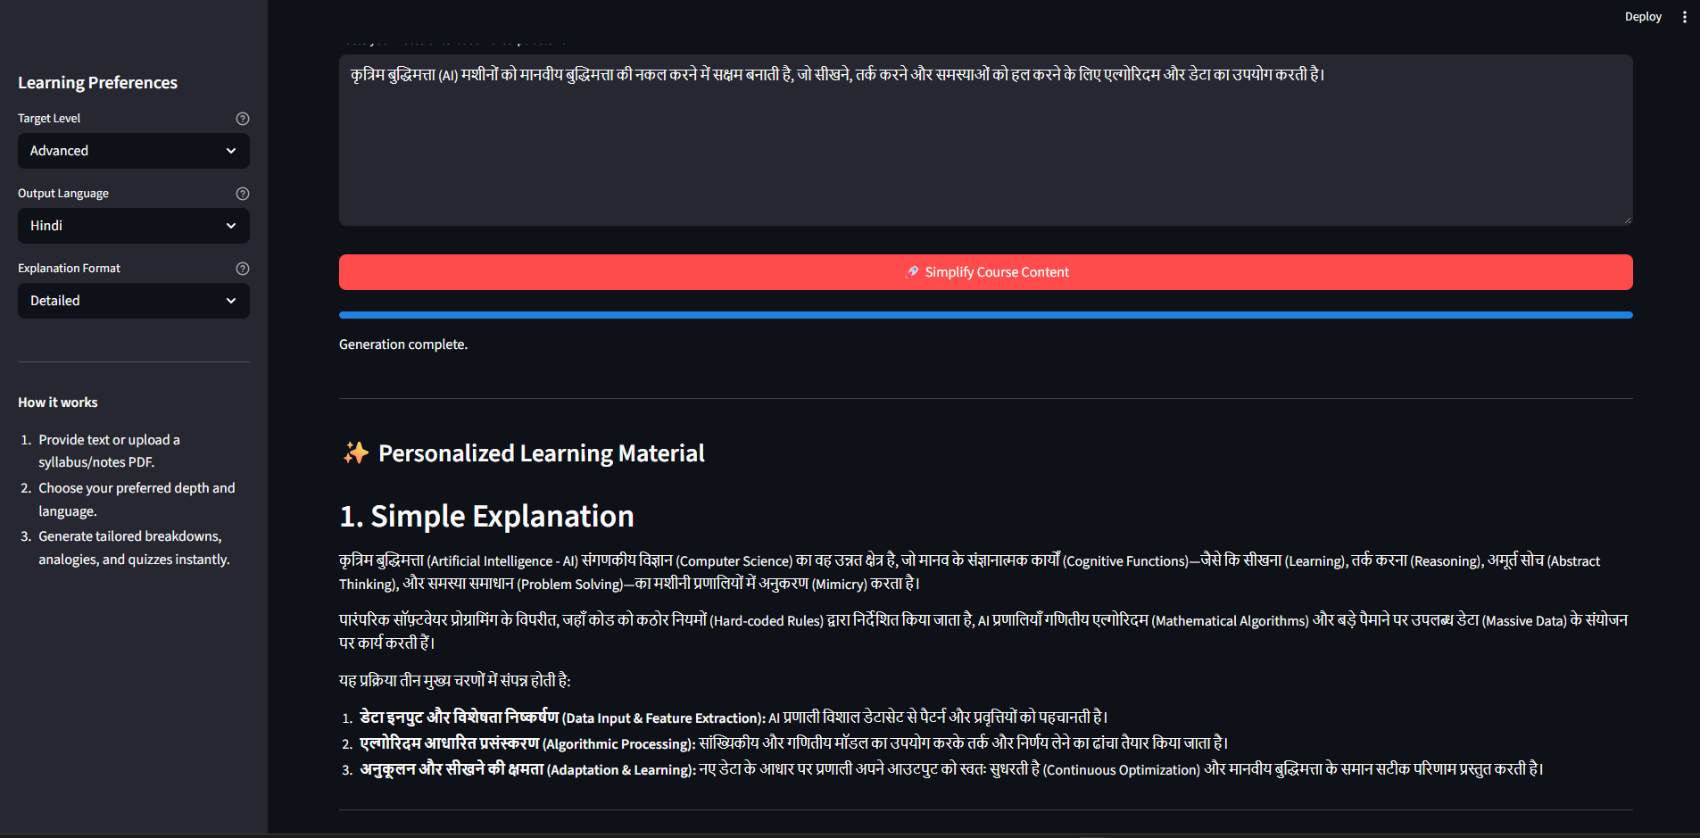
Multilingual Learning Option

Slide 20
Future Scope
1. AI-Powered Voice Assistant & Multilingual Expansion –
The system can be enhanced with a voice-enabled learning assistant and additional regional languages. Students will be able to interact naturally through voice and receive simplified academic explanations in their preferred language, improving accessibility and inclusiveness.
2. Personalized Learning Progress Tracking –
The system can track a student's topics studied, quiz performance, learning level, and revision history to provide more personalized recommendations and identify areas that require additional attention.
3. Voice-Based & Interactive Learning –
Students could ask questions verbally and receive spoken explanations, examples, and revision assistance, making the system more accessible for different learning preferences.
4. Integration with Educational Platforms –
EduSimplify AI could be integrated with Learning Management Systems (LMS), digital classrooms, and institutional course repositories to automatically simplify course materials and support students throughout their academic journey.
·
·
·

Slide 21
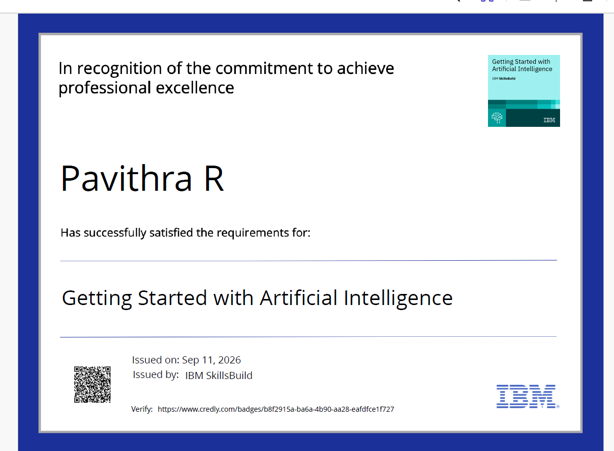
Certificates Earned:
Please add your credly certificate

Slide 22
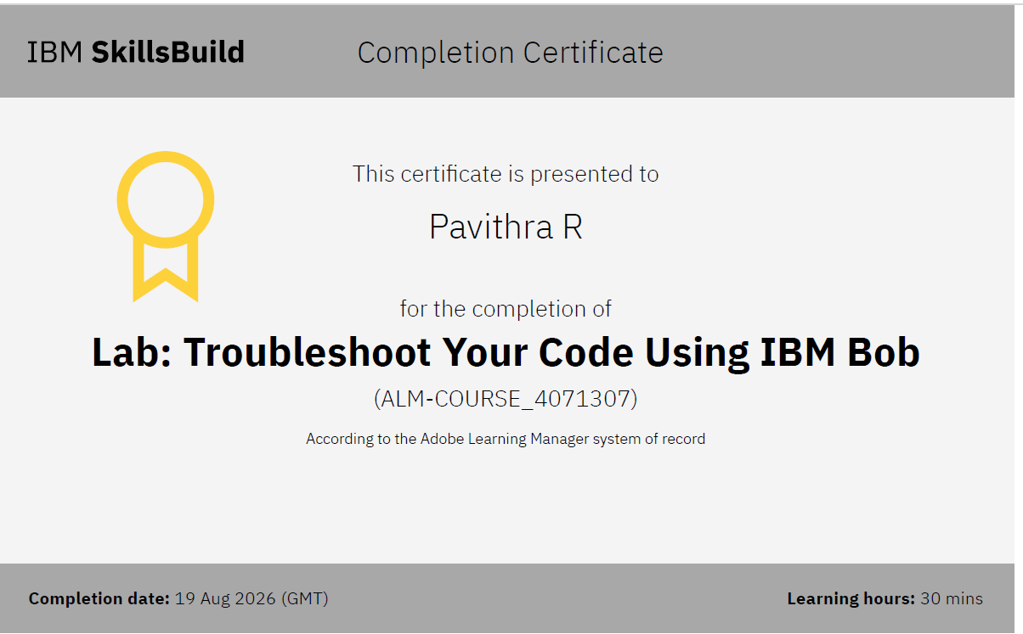
Certificates Earned:​
Add your IBM BOB Certificate

Slide 23


